Slide 1
ECMAScript
By - Hanumantha Reddy G S
www.codebydev.com
@codebydev

Slide 2
JavaScript History
What is ECMAScript is all about?
ECMAScript Time line
What is a Transpiler
ES6 features

Slide 3
JavaScript History
• May 1995, Created in ten days by Brendan Eich at Netscape: “Mocha”
• September 1995, shipped in beta of Netscape Navigator 2.0:“LiveScript”
• December 1995, Netscape 2.0b3:“JavaScript”
• August 1996, JavaScript cloned in Microsoft IE 3.0:“JScript”

Slide 4


Slide 5


Slide 6


Slide 7


Slide 8


Slide 9
What is ECMA?
Responsible for developing standards, including:
ALGOL – TC5 Ada – TC27
COBOL – TC6 C# - TC39/TC49
Fortran – TC8 CLI – TC39/TC49
PL/1 – TC10 Eiffel – TC49
Basic – TC21
Notes:
http://www.ecma-international.org/
JavaScript has a strange naming history. For its initial release in 1995 as part of Netscape Navigator, Netscape labeled their new language LiveScript, before renaming it to JavaScript a year later, hoping to capitalize on Java’s popularity at the time (JavaScript has no actual relationship to Java). In 1996 Netscape submitted JavaScript to ECMA International for standardization. This eventually resulted in a new language standard, labeled ECMAScript. All major JavaScript implementations since have actually been implementations of the ECMAScript standard, but the term JavaScript has stuck for historical and marketing reasons ¹. In the real world ECMAScript is usually used to refer to the standard while JavaScript is used when talking about the language in practice.
This has mostly been trivia for JavaScript developers, because ECMAScript didn’t change much for the first 15 years of its existence, and real world implementations often differed significantly from the standard. After the initial version of ECMAScript, work on the language continued and two more versions were quickly published. But after ECMASCript 3 came out in 1999, there were no changes made to the official standard for a decade. Instead various browser vendors made their own custom extensions to the language, and web developers were left to try and support multiple APIs. Even after ECMAScript 5 was published in 2009, it took several years for wide browser support of the new spec, and most developers continued to write code in ECMAScript 3 style, without necessarily being aware of the standard.
Around 2012 things started to change. There was more of a push to stop supporting old Internet Explorer versions, and writing code in ECMAScript 5 (ES5) style became much more feasible. At the same time work was underway on a new ECMAScript standard, at which point it became much more common to start referring to JavaScript implementations in terms of their support for different ECMAScript standards. The new standard was originally named ES.Harmony, before eventually being referred to as ECMAScript 6th Edition (ES6). In 2015 TC39, the committee responsible for drafting the ECMAScript specifications, made the decision to move to a yearly model for defining new standards, where new features would be added as they were approved, rather than drafting complete planned out specs that would only be finalized when all features were ready. As a result ECMAScript 6th edition was renamed ECMAScript 2015 (ES2015) before it was published in June.
Currently there are several proposals for new features or syntax to be added to JavaScript. These include decorators, async-await, and static class properties. These are often refered to as ES7, ES2016, or ES.Next features, but should realistically be called proposals or possibilities, since the ECMAScript 2016 specification hasn’t been written yet, and might include all or none of those features. TC39 divides proposals into 4 stages. You can see the current state of various proposals on the TC39 Github repo.
So where does that leave us in terms of terminology? The following list might be helpful:
ECMAScript: A language standardized by ECMA International and overseen by the TC39 committee. This term is usually used to refer to the standard itself.
JavaScript: The commonly used name for implementations of the ECMAScript standard. This term isn’t tied to a particular version of the ECMAScript standard, and may be used to refer to implementations that implement all or part of any particular ECMASCript edition.
ECMAScript 5 (ES5): The 5th edition of ECMAScript, standardized in 2009. This standard has been implemented fairly completely in all modern browsers
ECMAScript 6 (ES6)/ ECMAScript 2015 (ES2015): The 6th edition of ECMAScript, standardized in 2015. This standard has been partially implemented in most modern browsers. To see the state of implementation by different browsers and tools, check out these compatibility tables.
ECMAScript 2016: The expected 7th edition of ECMAScript. This is scheduled to be released next summer. The details of what the spec will contain have not been finalized yet
ECMAScript Proposals: Proposed features or syntax that are being considered for future versions of the ECMAScript standard. These move through a process of five stages: Strawman, Proposal, Draft, Candidate and Finished.
Going forward in this blog, I’ll be referring to the recent ECMAScript version as ES6 (since that is how it is best known by most developers), next years spec as ES2016 (since that will be what it is called the whole way through its standardization process, unlike ES6/ES2015) and future language ideas that are not yet part of a draft or finalized spec as ECMAScript proposals or JavaScript proposals. I’ll do my best to point back to this post in any cases that might be confusing.
More Resources
TC39 has a github repo tracking all of their current open proposals.
If you aren’t familiar with ES6 yet, Babel has a great rundown of its features
If you want to go deeper with ES6 I’ve heard great things about 2 books on the subject: Exploring ES6 by Axel Rauschmayer and Understanding ECMAScript 6 by Nicholas Zakas². Axel’s blog 2ality is also a great ES6 resource.
And obviously because ECMAScript is an awful language name
↩
Note that I have not read either of these books yet, though I have read plenty of other content from both authors and consider them experts on the JavaScript language. So take that recommendation with an appropriate grain of salt.

Slide 10
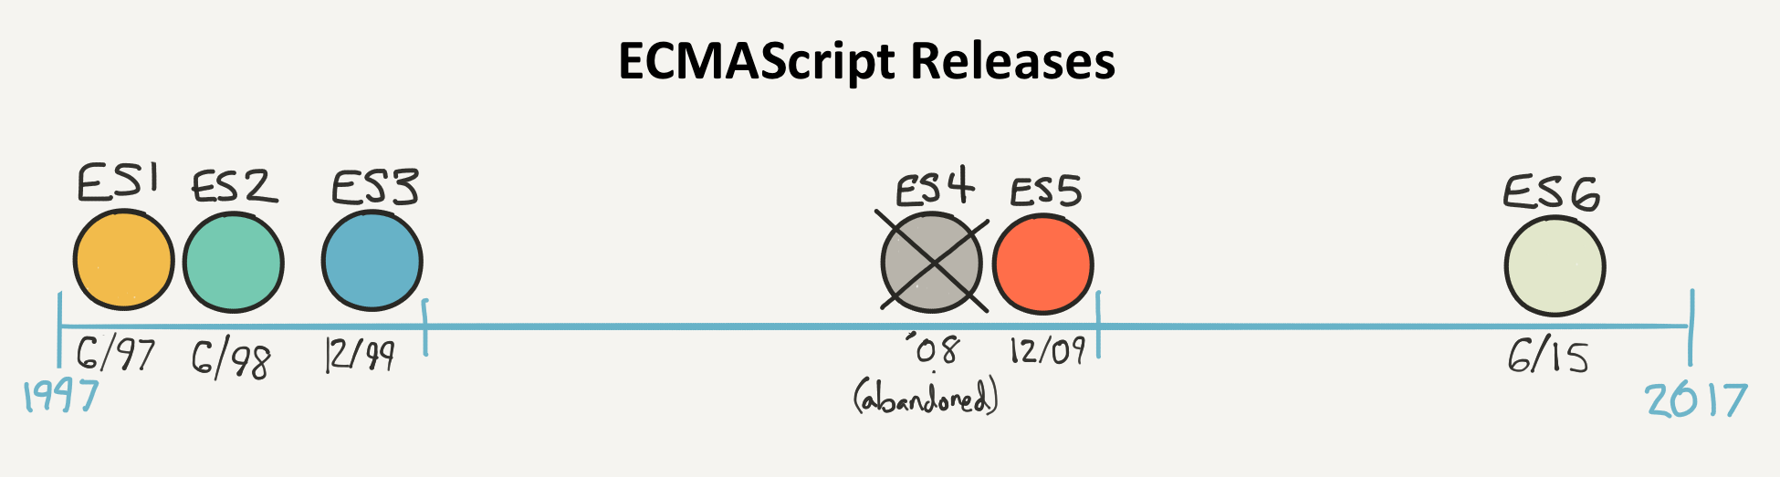
ECMAScript Time line
Notes:
In the real world ECMAScript is usually used to refer to the standard while JavaScript is used when talking about the language in practice.

Slide 11
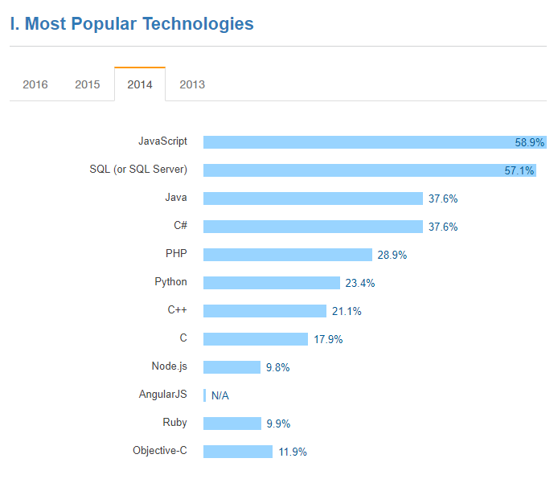

Slide 12
Kangax – ES feature compatibility

Slide 13
What is a Transpiler
A source-to-source compiler
List of ES6 Transpilers
Babel -To transpile ES6 into ES5 for static builds
Traceur - ES6 features > ES5. Includes classes, generators, promises, destructuring patterns, default parameters & more.
Notes:
transcompiler or transpiler is a type of compiler that takes the source code of a program written in one programming language as its input and produces the equivalent source code in another programming language. A source-to-source compiler translates between programming languages that operate at approximately the same level of abstraction, while a traditional compiler translates from a higher level programming language to a lower level programming language

Slide 14
ES6 features
Default parameter
Const Keyword
Let Keyword
Template Strings
Spread Operator
Object Literal Enhancement
Arrow Functions
Arrow Functions and 'this'
Destructuring Assignment
Generators
Classes
Classes With Inheritance

Slide 15
References
https://github.com/lukehoban/es6features
https://github.com/addyosmani/es6-tools
http://kangax.github.io/compat-table/es6/
http://babeljs.io/
https://github.com/bevacqua/es6#introduction
http://coenraets.org/present/es6/#0
https://lightrains.com/blogs/function-parameteres-ecmascript6-es6
http://ccoenraets.github.io/es6-tutorial/
http://es6-features.org/#Constants
https://leanpub.com/understandinges6/read
http://exploringjs.com/

